Slide 1
Real time heart rate monitoring and BPM display
A presentATION by group 2

Slide 2
Group members
1/ Naimur Rahman 021 221 043
2 Md. Ratul Hassan 021 221 036
3/ Md. Nayon Khan 021 221 045
4/ Khandaker Mahmudul Hasan 021 221 050

Slide 3
Table of contents
Components
Circuit block diagram
Circuit
Simulation
How dose the circuit receive the heartbeat and filter it?
Input receiving circuit and the filter
How does it count the heartbeats and convert them into binary and BCD?
Binary to BCD converting circuit
Binary to BCD circuit
BCD to 7 segment display
Applications areas
What have we learned??
cost

Slide 4
Components
1/ IC LM741 5/ IC NE555N
2/ IC 74LS161 6/ IC CD4511
3/ IC 74HC11 7/ 7 SEGMENT CATHODE DISPLAY
4/ IC 74LS08 8/ STETHOSCOPE
5/ IC 74LS32 9/MICROPHONE
6/ RESISTORS 10/CONNECTING WIRES

Slide 5
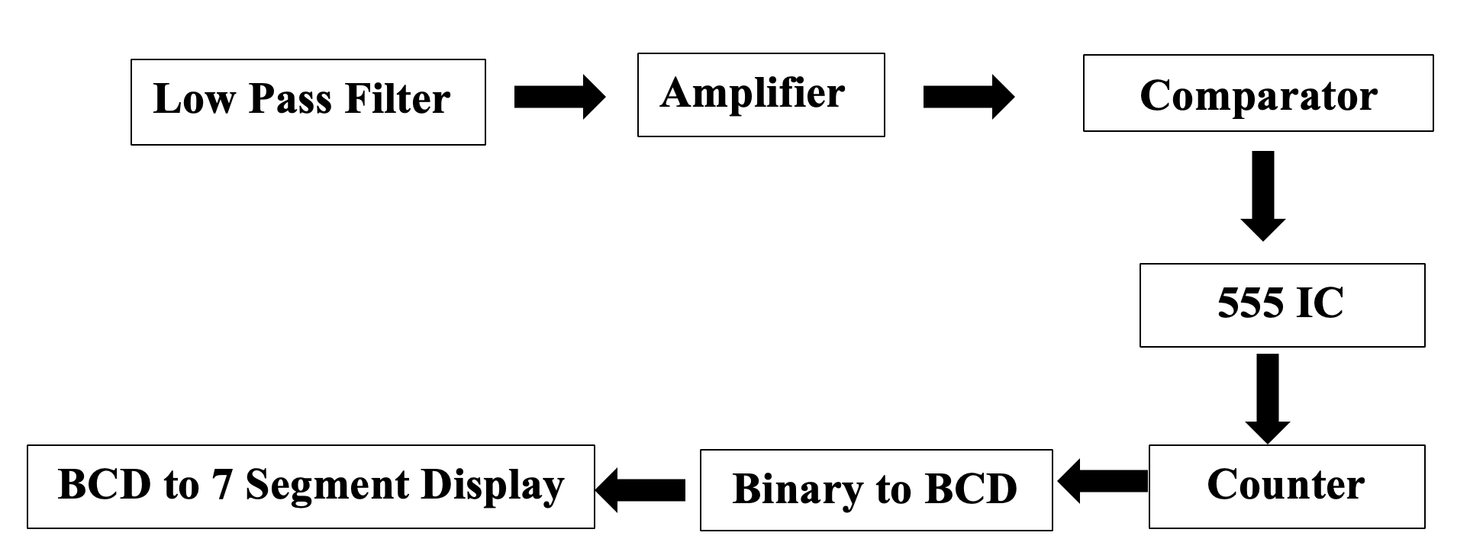
Circuit Block Diagram

Slide 6
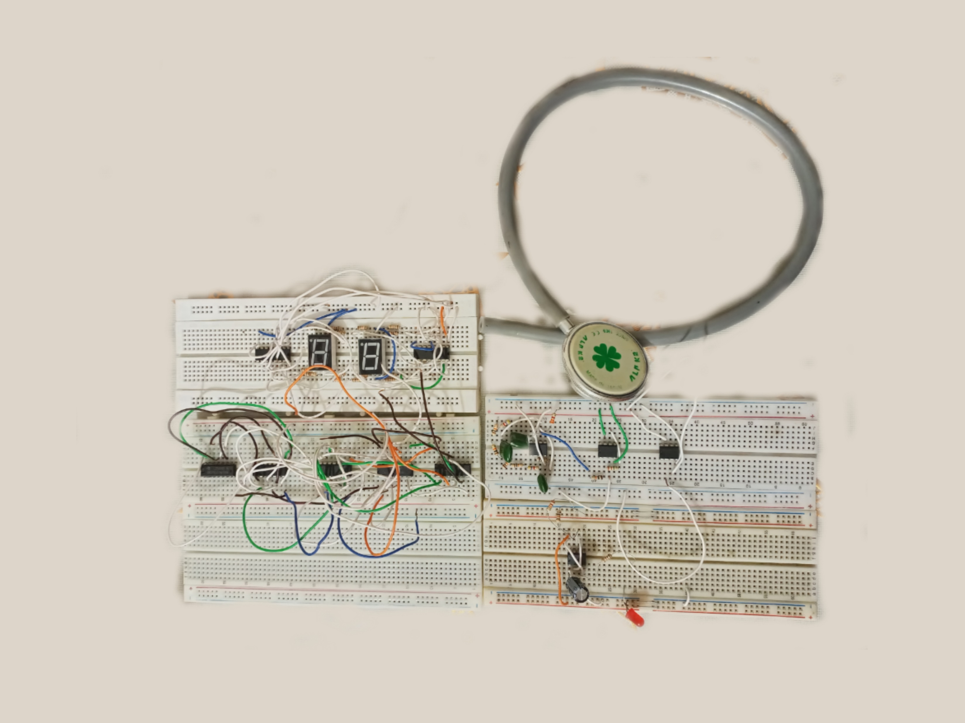
CIRCUIT

Slide 7
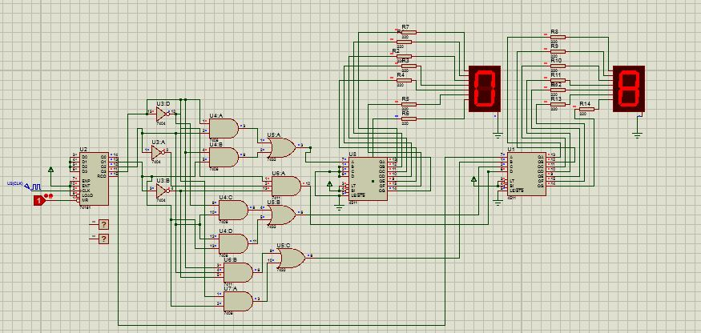
Simulation
Simulation using Proteus

Slide 8
How does the circuit receive the heartbeat and filter it ?
STETHOSCOPE
MICROPHONE
AMPLIFIRE
LOW PASS FILTER

Slide 9
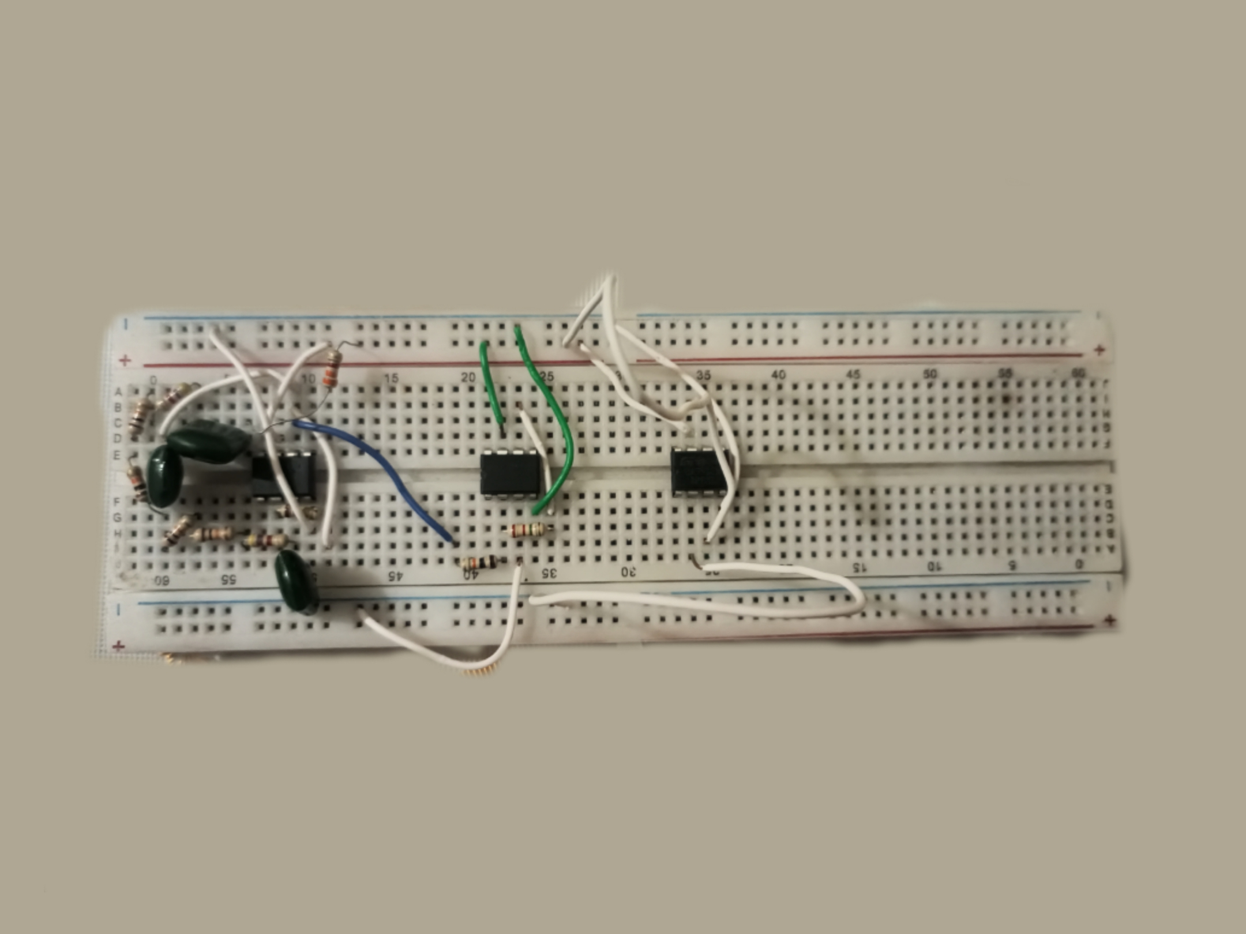
Input receiving circuit and the filter

Slide 10
How does it count the heartbeats and convert them into binary and BCD?
Counter IC
Converting circuit binary to BCD?

Slide 11
Binary to BCD converting circuit
Analysis of the output in 7 segment display
K-map
Implementing the circuit using logic gates

Slide 12
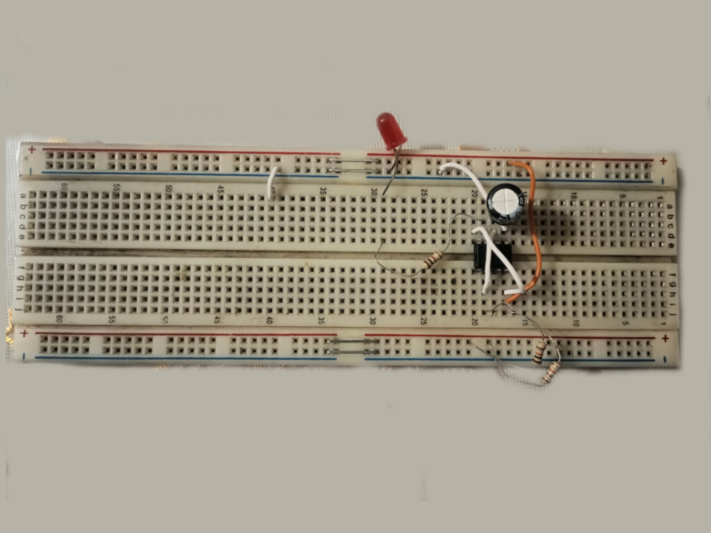
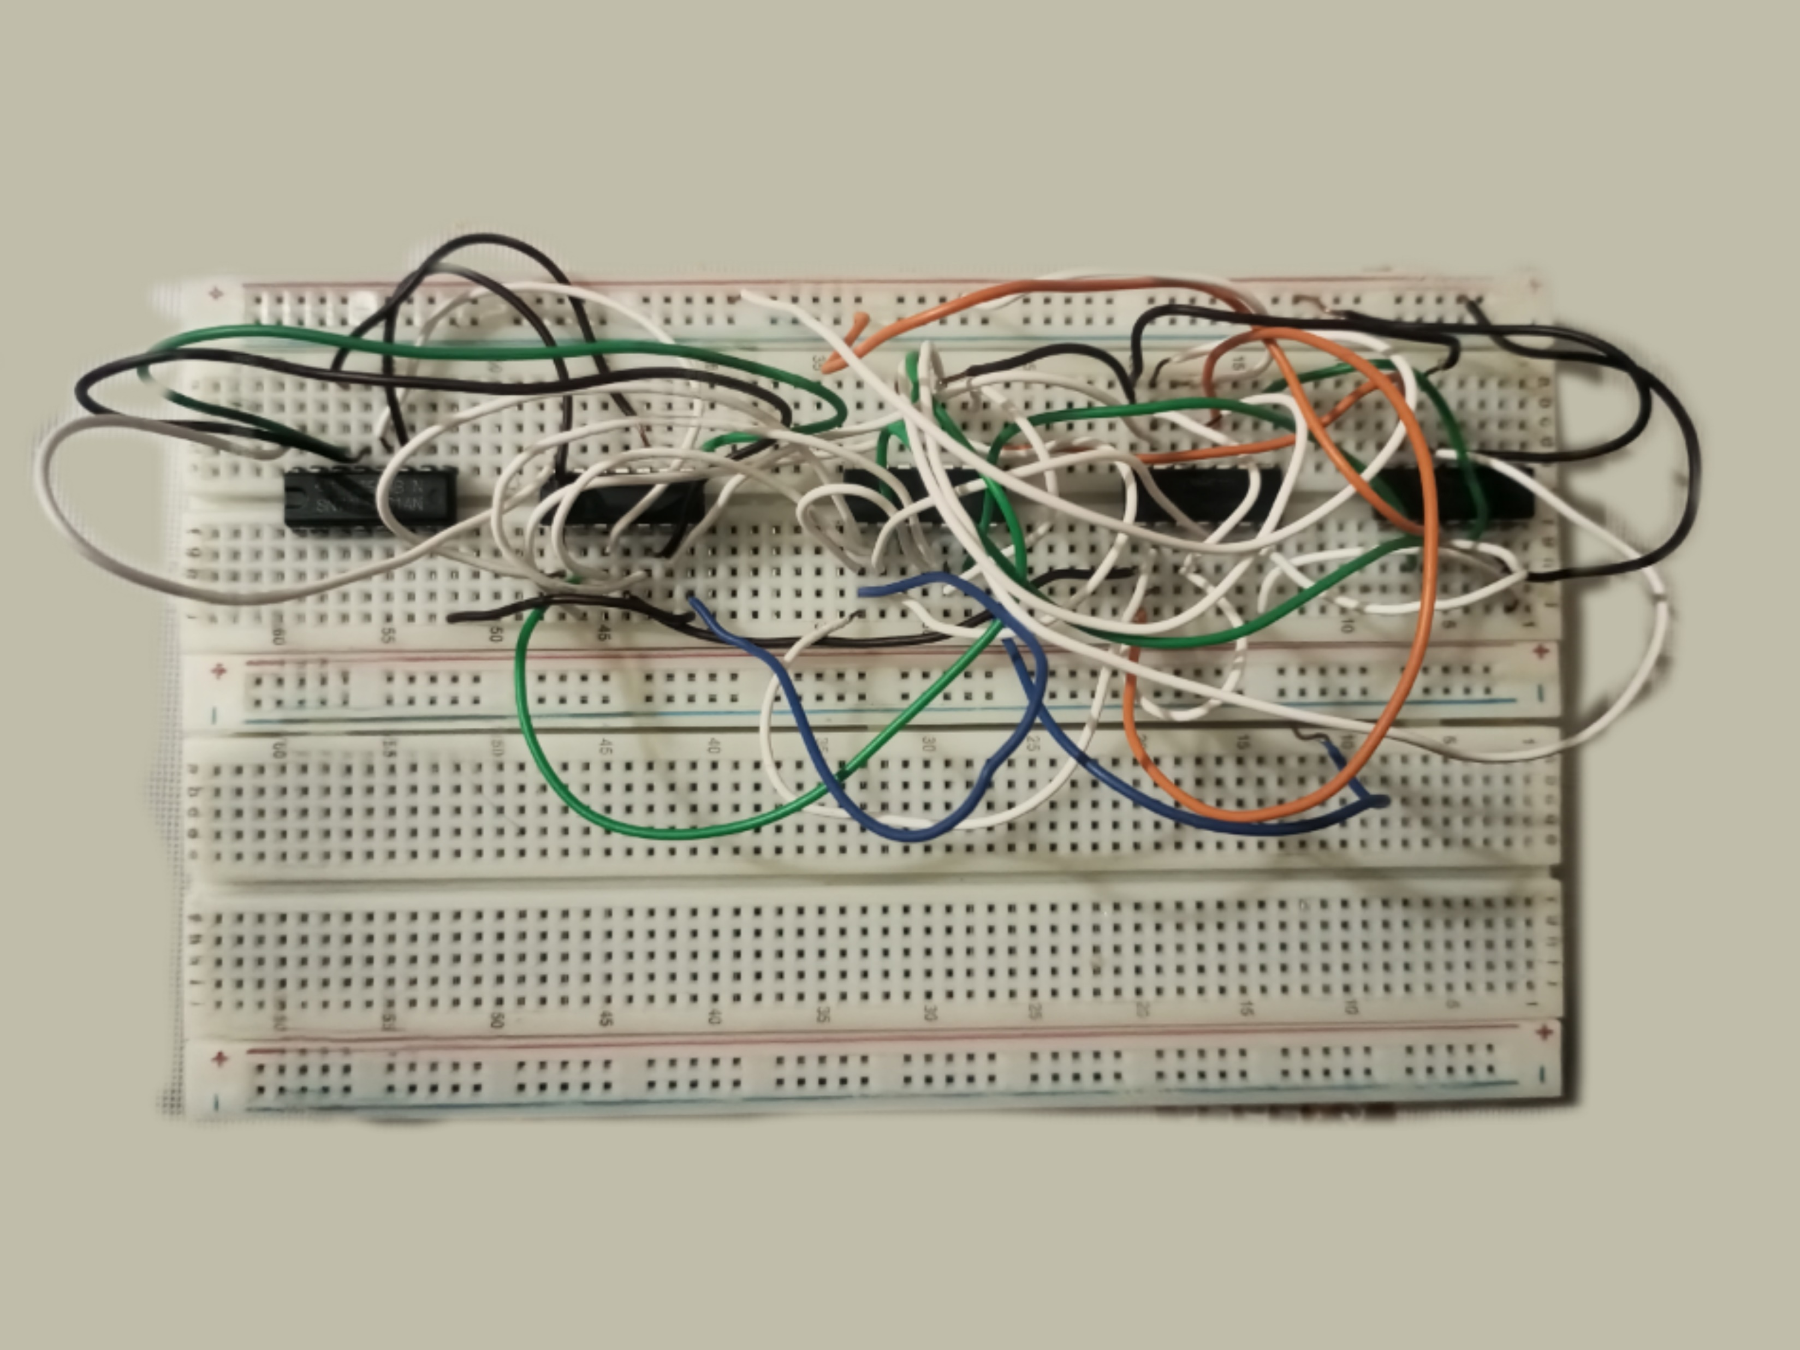
Binary to BCD circuit

Slide 13
BCD to 7 segment display
BCD input at IC CD 4511
Output at 7 segment display
How dose 7 segment display work?
Taken safety procedure for 7 segment display

Slide 14
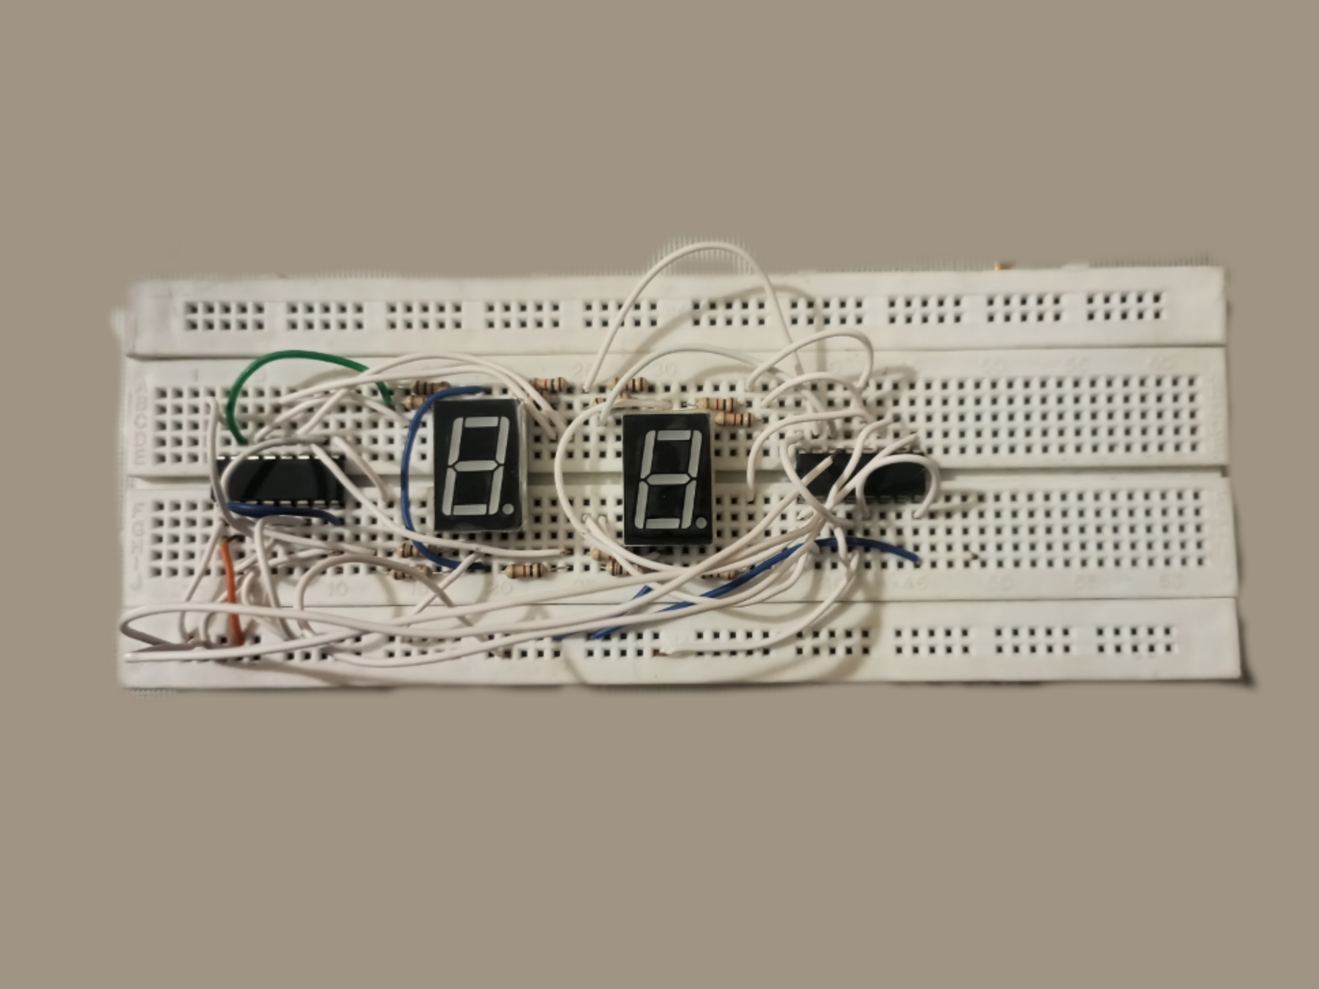
BCD to 7 segment circuit

Slide 15
Applications areas
Measuring BPM
Telemedicine
Fitness training
Research purposes

Slide 16
What have we learned??
Uses of Op-Amps
Deep knowledge of IC’s
Analysis of signal
Designing a circuit based on outputs
Finding errors and solving it

Slide 17
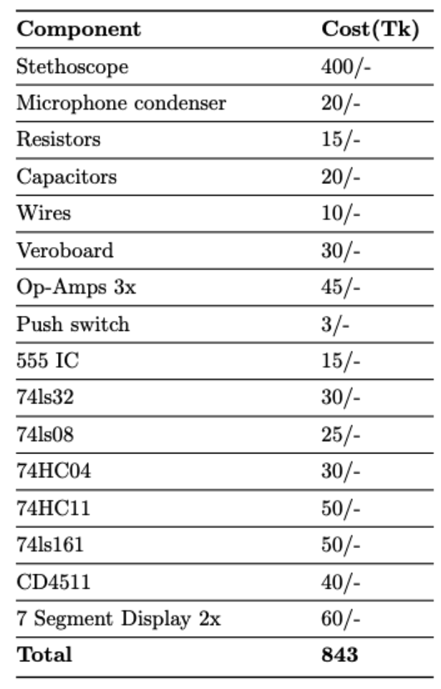
cost

Slide 18
Thank you

